Slide 1
Today’s objective
Collect the paper on Mark Pollitt’s video.
Collect the Lab Five – RAM analysis
Go over Lab Six – bring to class on Wednesday (03/06)
Go over the exam
Team Project
  March 22th (Checkpoint presentation)
  Wednesday class - visiting with each team
Windows file system

Slide 2
Windows file system
Why talk about the operating system and numbering systems?
File systems - prevalent devices that you are likely to encounter during a forensics investigation.
Boot process
Physical vs logical storage
Windows forensics
  File systems
  The registry

Slide 3
What is an operating system?
Need a strong foundation in operating systems to be an effective investigator. Why?
Need an understanding of numbering systems? Why?

Slide 4
Why?
The evidence investigators work with are files.
The organization of these files, the data they contain, and their locations varies according to the operating system and associated file system on device.
The type of operating system and file system determine acquisition and analysis.
A file system is a hierarchy of files and their respective directories.

Slide 5
Numbering systems?
Forensics investigators need to convert from different formats because the forensics software displays system and user data in different formats.
Most computer forensics imaging software includes a hex editor that enables a forensics examiner to view the entire contents of a file.

Slide 6
What is a file system?
File system
  Gives OS a road map to data on a disk
Type of file system an OS uses determines how data is stored on the disk
When you need to access a suspect’s computer to acquire or inspect data
  You should be familiar with both the computer’s OS and file systems

Slide 7
Today’s coverage
Boot process
  What does booting mean?
Physical vs logical storage
Windows forensics
  File systems
  The registry

Slide 8
Booting your computer
Loading an operating system into the computer's RAM.
Once loaded → Windows Desktop screen.
What are the main concepts we need to know?
  BIOS
  CMOS (Complementary Metal Oxide Semiconductor)
  Bootstrap process

Slide 9
BIOS
ROM chip
On motherboards that allows you to access and set up your computer system at the most basic level.
Includes instructions on how to load basic computer hardware.
POST(Power On Self Test – that helps verify the computer meets requirements to boot properly.

Slide 10
Four main functions of BIOS
POST -Test the computer hardware for errors before loading the operating system.
Bootstrap loader – locates the operating system. →passes control to OS if loaded.
BIOS drivers - give the computer basic operational control over your computer's hardware
BIOS or CMOS Setup - allows for configuration of hardware settings including system settings passwords, time, and date.

Slide 11
CMOS
On the motherboard
Battery powered semiconductor chip inside computers that stores information:
  System time and date to system hardware settings for your computer

Slide 12
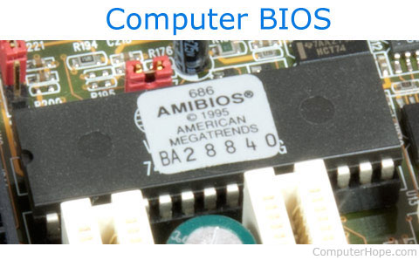

BIOS and CMOS battery

Slide 13
Master Boot Record (MBR)
The information in the first sector on a hard disk (Sector 0).
Identifies where the OS is located → so it may boot into the computer’s RAM
The BIOS always looks at Sector 0 for instructions on how to load the operating system

Slide 14
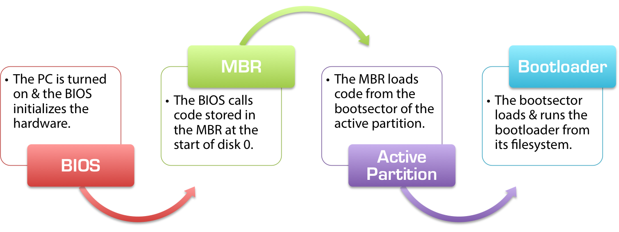
Boot process

Slide 15
NOTE the following
An investigator removes the suspect’s hard drive, and that hard drive is then cloned or imaged.
An investigator has to document information about the system and its specifications.
Therefore, the investigator starts the computer with the hard drive removed to prevent changes to the hard drive.
Remember that a user might have password-protected the BIOS

Slide 16
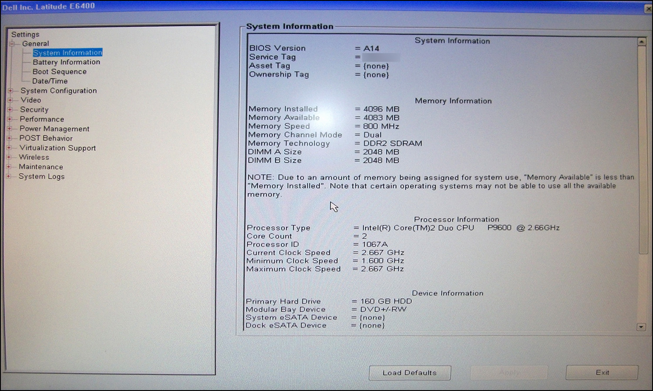
Viewing the BIOS

Slide 17
BIOS set up
Why do we care about BIOS set up?
How do you get into the BIOS on your laptop?
Why would you need to get into the BIOS?

Slide 18
Lets get practical
Need a keyboard to access the BIOS
Press the power button to start your computer.
Press the F2 button on your keyboard several times to prevent the BIOS from loading. F2 is the function key that stops the BIOS from loading.
Another key also might be used to access the BIOS.
Use the arrow key to scroll down to the BIOS

Slide 19
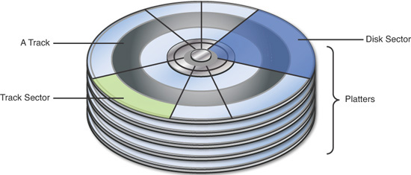
Data on the disk drive
The Layout of a Hard Drive

Slide 20
Physical and logical storage
Sector- 512 bytes(magnetic hard disk) 2048 bytes (optical disks).
Bad sector -is an area of the disk that can no longer be used to store data.
A cluster-is a logical storage unit on a hard disk that contains contiguous sectors.
Partition – has number of sectors in a cluster

Slide 21
Physical and logical size
Physical size -is dictated by the minimum number of clusters a file needs.
Logical size – the actual size of the file.
Think of a 6KB file, which you want to store on a hard disk, the cluster size is 4KB. How many clusters do you need?

Slide 22
Slack space
  Taking up 1.5 clusters (with each cluster=4KB)
  Need 2 clusters for space (8KB –physical size)
  Actual file size – logical size
  The 2KB – file slack.

Slide 23
What you need to know!
Most users aren't very good at covering their tracks.
Incriminating file or memory content stored in various locations invisible to the subject of an investigation.
  Deleted files and slack space
  Swap space
  Hibernation files

Slide 24
Deleted files/slack space
Writing files to disk – OS allocates a number of sectors.
Sectors allocated and their location on the disk are recorded in a directory table for later access.
When file is deleted – space is unallocated – data remains on the disk
Note the slack space

Slide 25
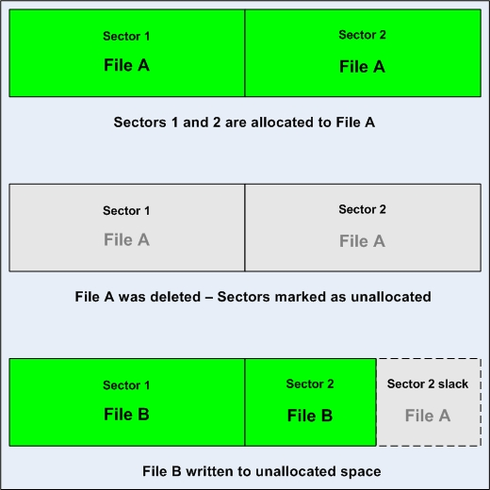
Slack space

Slide 26
Swap space
Both Linux and Microsoft Windows systems expand RAM by using disk.
The area on disk used for this purpose is called the swap file or swap space (in Linux – this is a disk partition).
Since everything in RAM is subject to being swapped to disk, some very interesting information can be found in a swap file.
  Encryption keys for some applications
  Disk maintenance utilities can access these.

Slide 27
Hibernation files
Created when a system goes into sleep or hibernation mode and stored on the hard disk.
This occupies a big space in Windows – you can disable it.
Can contain a wealth of information not found anywhere else on the target system.

Slide 28
Today’s coverage
Master Boot Record
Using a Hex editor to view partitions and clusters

Slide 29
Master Boot Record (MBR)
The information in the first sector on a hard disk (Sector 0).
Identifies where the OS is located → so it may boot into the computer’s RAM
The BIOS always looks at Sector 0 for instructions on how to load the operating system

Slide 30
Microsoft File Structures
In Microsoft file structures, sectors are grouped to form clusters
  Storage allocation units of one or more sectors
Clusters range from 512 bytes up to 32,000 bytes each
Combining sectors minimizes the overhead of writing or reading files to a disk

Slide 31
Exploring Microsoft File Structures
Clusters are numbered sequentially starting at 0 in NTFS and 2 in FAT
  First sector of all disks contains a system area, the MBR record, and a file structure database
Clusters and their addresses are specific to a logical disk drive, which is a disk partition

Slide 32
Disk Partitions
A partition is a logical drive
Windows OSs can have three primary partitions followed by an extended partition that can contain one or more logical drives
Hidden partitions or voids
  Large unused gaps between partitions on a disk
Partition gap
  Unused space between partitions

Slide 33
MBR has the following
Master Partition Table:
  Contains descriptions about the partitions
  Only room for 4 descriptions User can only create a logical partition, with a link to primary partition.
Master Boot Code:
  Used by the BIOS to start the boot process.
Disk Signature:
  Identifies the disk to the operating system.

Slide 34
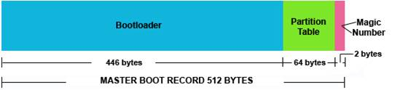
Generic MBR

Slide 35
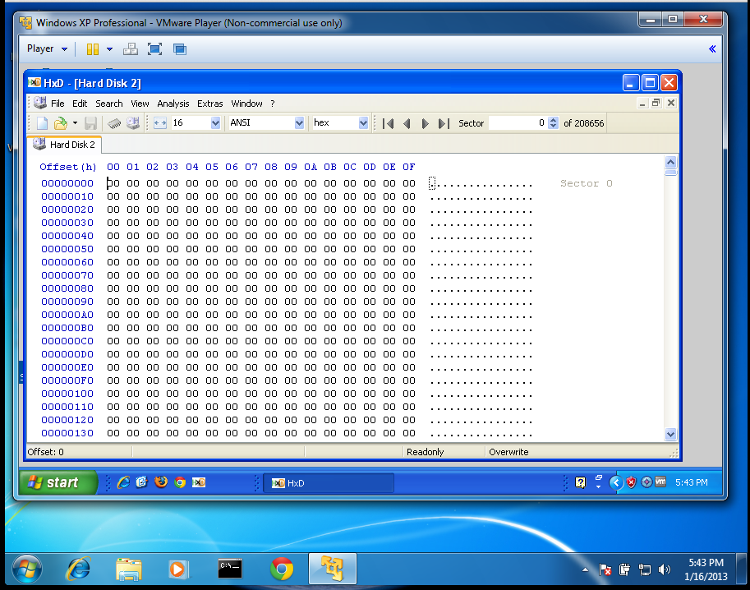
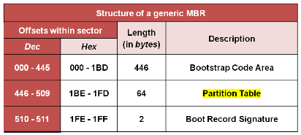
Addresses

Slide 36
HxD
Each horizontal row shows 16 bytes, labeled with the Offset (h) value in hexadecimal at the top.
On the left, the byte value is shown in hexadecimal. On the right, it's shown in ASCII.
Every byte is zero. Why?
In the upper right, notice that you are viewing "Sector 0 of 208656". Each sector contains 512 bytes, so that is a total of 208,656 x 512 bytes = 106,831,872 bytes. This is approximately 100 million bytes, or 0.1 GB.

Slide 37
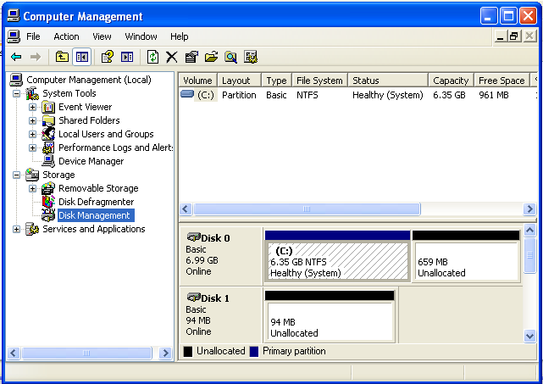
Initialize the disk

Slide 38
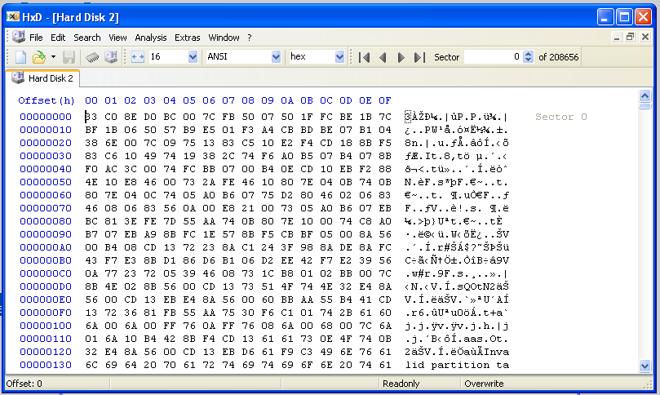
Now you have the MBR

Slide 39
Addresses

Slide 40
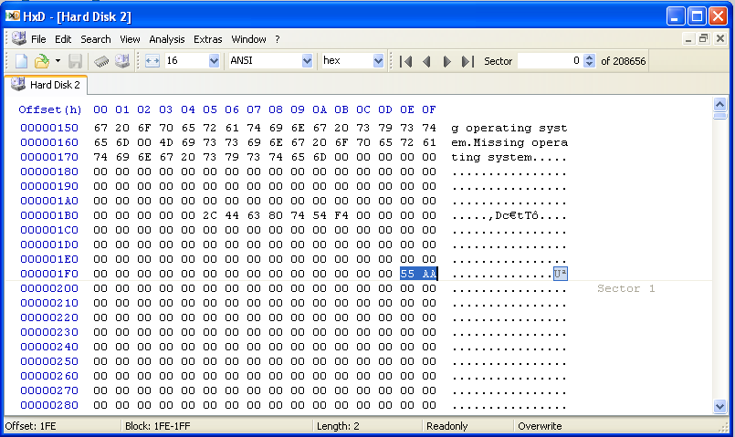
MBR

Slide 41
Locations
Start of Partition Table: Locations 01BC and 01BD contain zeroes
Partition Table: Locations 01BE through 01FD contain 64 bytes of zero. These are four 16-byte records, which specify the four possible partitions on a Basic Disk. Since there are no partitions on the disk, they are all zero now.
End of Boot Sector: Locations 01FE and 01FF contain 55 and AA. This is the MBR Signature--it marks the end of the MBR, and also the end of the Partition Table.

Slide 42
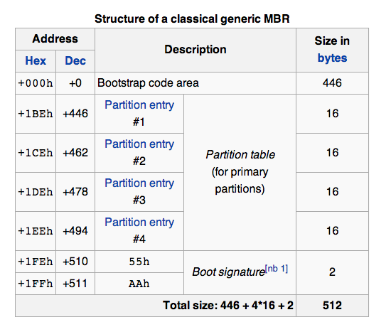
Structure of MBR

Slide 43
Disk Partitions
A partition is a logical drive
Windows OSs can have three primary partitions followed by an extended partition that can contain one or more logical drives
Hidden partitions or voids
  Large unused gaps between partitions on a disk
Partition gap
  Unused space between partitions

Slide 44
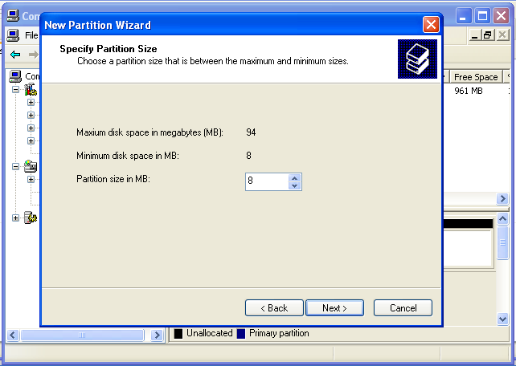
Creating a new partition

Slide 45
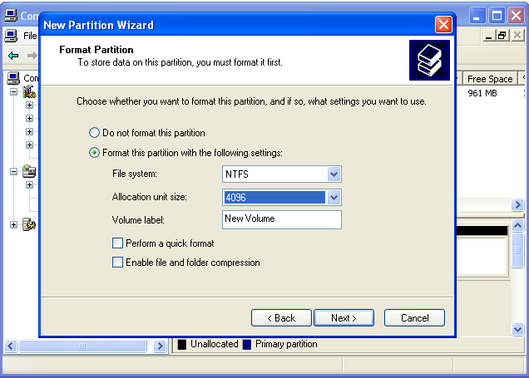
Partition

Slide 46
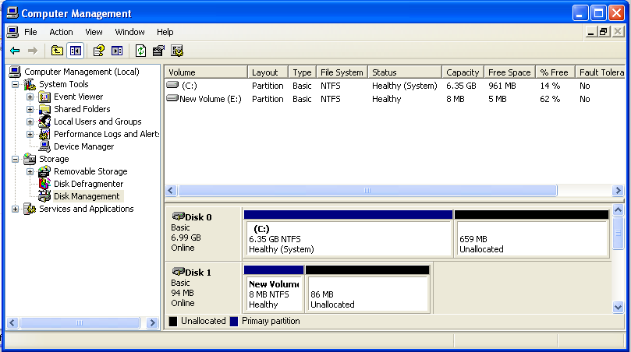
Newly created partition

Slide 47
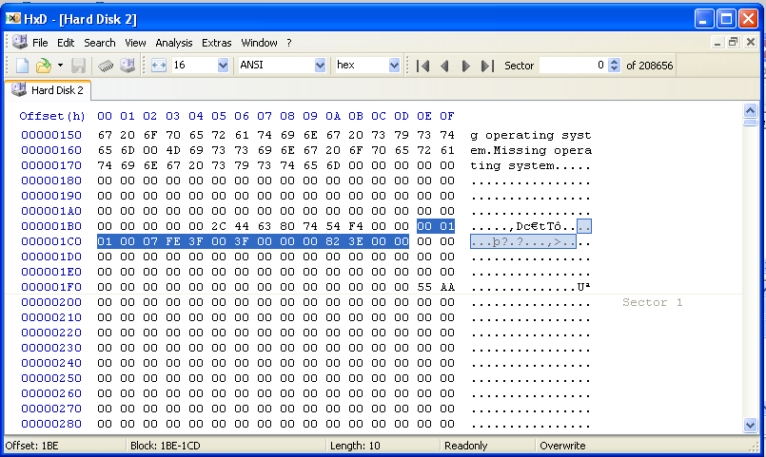
partition

Slide 48
Windows File systems
Microsoft Windows supports five file systems: NTFS, FAT64, FAT32, FAT16, and FAT12.
FAT (File Allocation Table)
  Utilizes a table to store information about where files are stored, where file space is available, and where files cannot be stored.
NTFS (New Technology File System)
  Replaced FAT. NTFS was developed by Microsoft and introduced with Windows NT.

